Slide 1
Introduction to human microbiome and metagenomics
Anujit Sarkar
Postdoctoral scholar, COPH, CON
USF Genomics Program
July 22, 2021

Slide 2
Interesting facts about microbes on Earth
The number of microbes in the oceans on earth is astonishing (100 million times more than the number of stars in the known universe)
The total number of bacteria on the earth is estimated to be 10E+30
If all the virus on Earth are laid end-to-end, it will strech beyond 100 million light years (100 times more than the diameter of milky way galaxy)
Interestingly, 20-40% of the bacteria are killed by viruses everyday!!!
One teaspoon of soil contains the number of bacteria equivalent to the human population of Africa

Slide 3
Facts about microbiome
Microbiome is the combined genetic material of all microbes residing on or within a particular niche which can be a living organism
The host and its microbes together is called holobiont
Microbiome is comprised of various components such as bacteria, archea, fungi, protozoa and viruses
Microbiome is much older than humans (3.50 billion years, compared to 250,000 years of human history)
There is a great microbiome beyond human body
The Earth microbiome project studied the diversity across various environments on the planet
Till now, we have sequenced only 10E-20% of the microbial genomes on earth

Slide 4
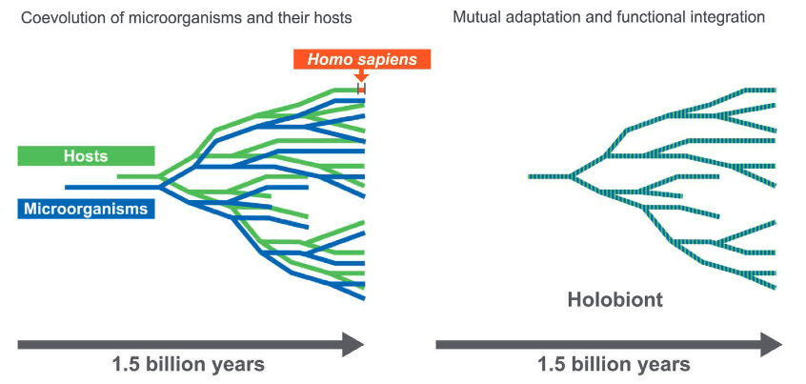
Coevolution of host and microbe
https://www.nature.com/articles/sj.bdj.2016.865

Slide 5
Introduction to human microbiome
https://link.springer.com/chapter/10.1007/978-981-10-7684-8_1
http://www.whatisbiotechnology.org

Slide 6
Facts about human microbiome
The total number of bacteria in human is ~39 trillion
Other microorganisms in the human body are several orders lower than the bacteria
The density of bacteria in dental plaque and colon in human is very high (10E+11 /gm)
The number of genes from the human microbiome exceed that of genome by 150-200-fold
Eight percent of human DNA is derived from the remnants of viral genomes

Slide 7
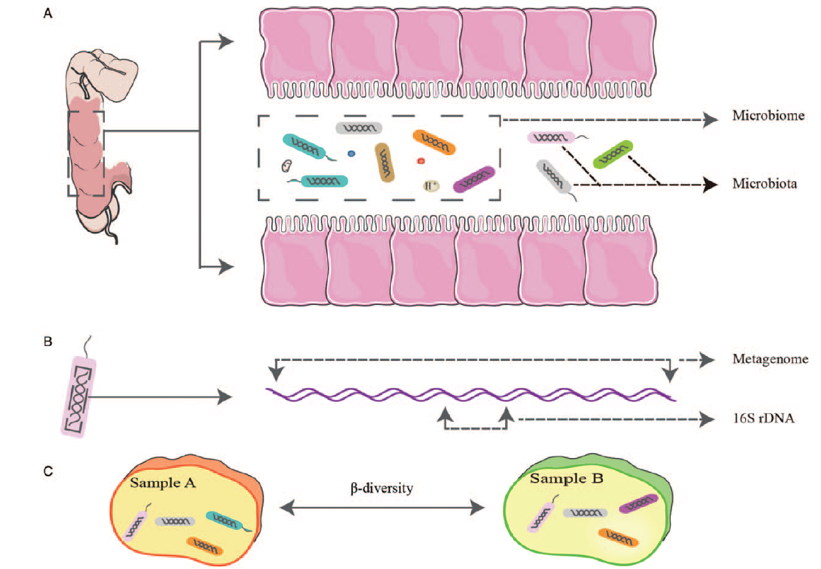
Some common terms in microbiome study
A guide to human microbiome research: study design, sample collection, and bioinformatics analysis - PubMed (nih.gov)

Slide 8
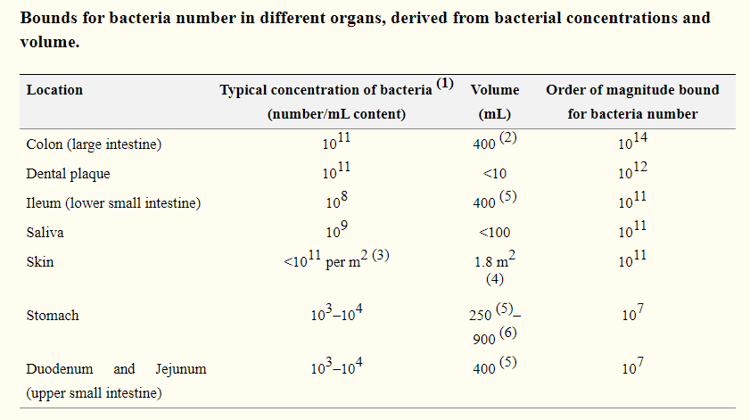
Bacterial abundance at various human body sites
https://www.ncbi.nlm.nih.gov/pmc/articles/PMC4991899/

Slide 9
Dynamics of human microbiome
https://www.ncbi.nlm.nih.gov/pmc/articles/PMC5962619/

Slide 10
Function and role of human microbiome
https://www.translationalmicrobiome.org/resources/publications/heterogeneity-of-the-gut-microbiome-in-mice-guidelines-for-optimizing-experimental-design/

Slide 11
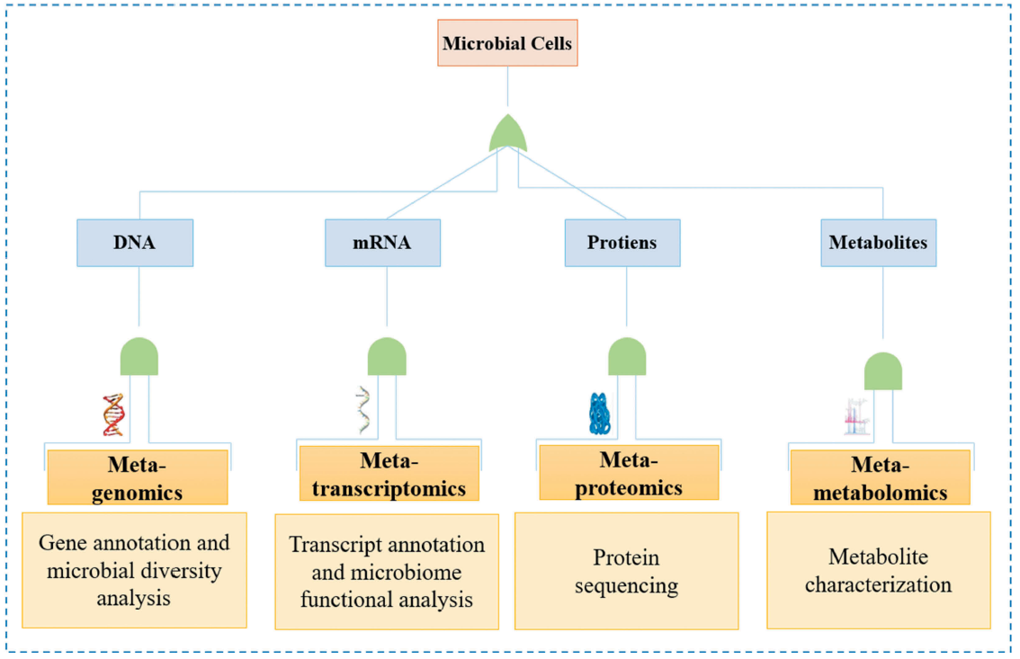
High throughput approaches for microbiome studies
Full article: Metagenomics for taxonomy profiling: tools and approaches (tandfonline.com)

Slide 12
High throughput microbiome approaches
Omics | Microbial meterial | Outcome | Advantages | Disadvantages
Marker genes (16S, ITS) | 16S rRNA | Microbiota composition | Fast and cheap | Low resolution, PCR bias
Metagenomics | Total DNA | Composition and function potential | High resolution, functional potential characterization | Higher cost, computaionally challenging
Metatranscriptomics | mRNA/cDNA | Gene expression differences | Reveal gene expression | mRNA instability, lack of standard database
Metaproteomics | Proteins | Protein expression profiling | Differences in proteins synthesized by microbiota | Technologically challenging
Metabolomics | Metabolites | Metabolic profiling | Reveal metabolite differences | Lack of reference database, many unknown metabolites

Slide 13

16S rRNA profiling
Different types of bacteria
All protozoa
All fungi
All viruses

Slide 14
16S rRNA profiling
Bikel, Shirley, et al." Computational and structural biotechnology journal 13 (2015): 390-401.

Slide 15
Differences between 16S and Metagenomic approaches
16S | Metagenomics
Targets only one gene | Targets the total DNA from all organisms
Involves PCR amplification step at the beginning | Doesn’t include an initial PCR step
Resolution upto genus level | Resolution upto genus/species/strain level
Less expensive | Expensive
Computationally less challenging | More challenging
Targets bacteria | Targets all microbes
Resistant to host contamination | Host contamination to be removed
Capable of providing composition | Capable of providing composition as well as functional potential

Slide 16
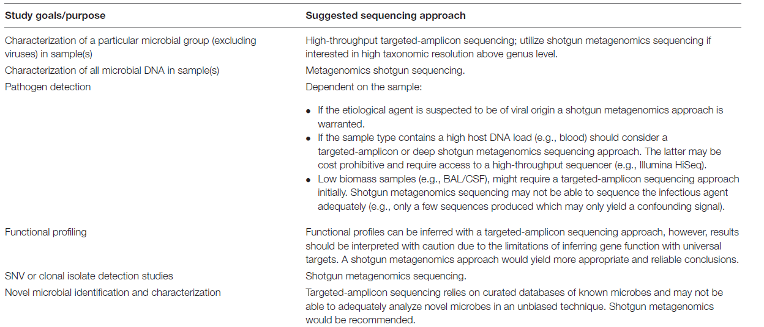
Choosing 16S or metagenomics based on purpose
Frontiers | Metagenomics: The Next Culture-Independent Game Changer | Microbiology (frontiersin.org)

Slide 17
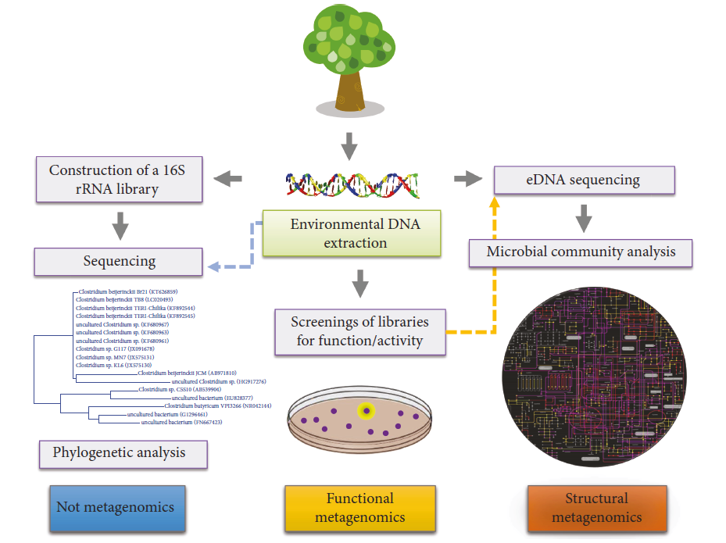
Metagenomics framework
Metagenomic Approaches for Understanding New Concepts in Microbial Science (hindawi.com)

Slide 18
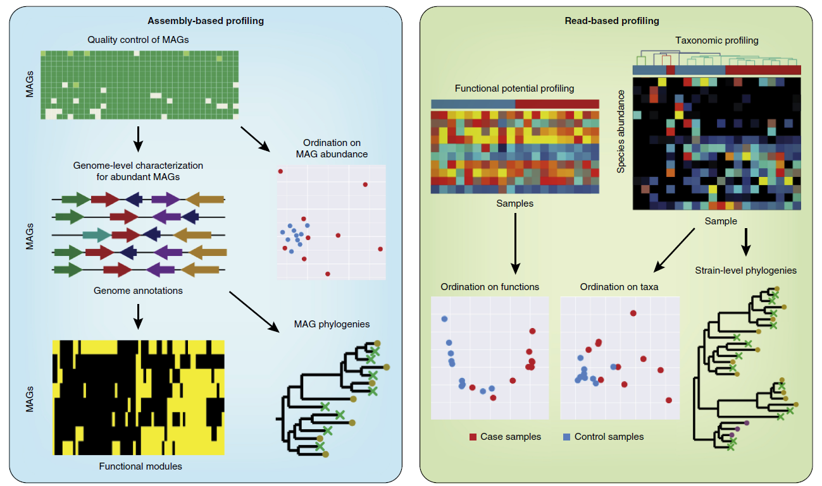
Read-based and assembly-based profiling
Shotgun metagenomics, from sampling to analysis | Nature Biotechnology

Slide 19
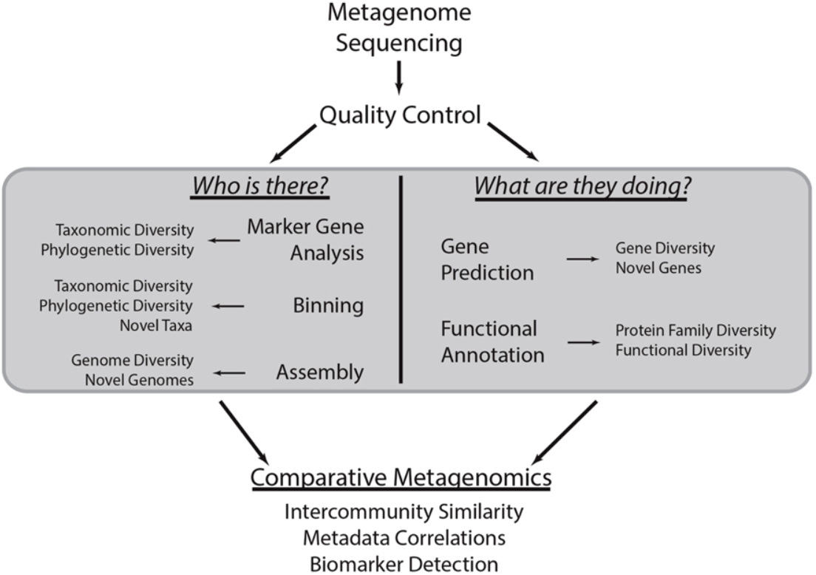
What metagenomics can tell
Frontiers | An introduction to the analysis of shotgun metagenomic data | Plant Science (frontiersin.org)

Slide 20
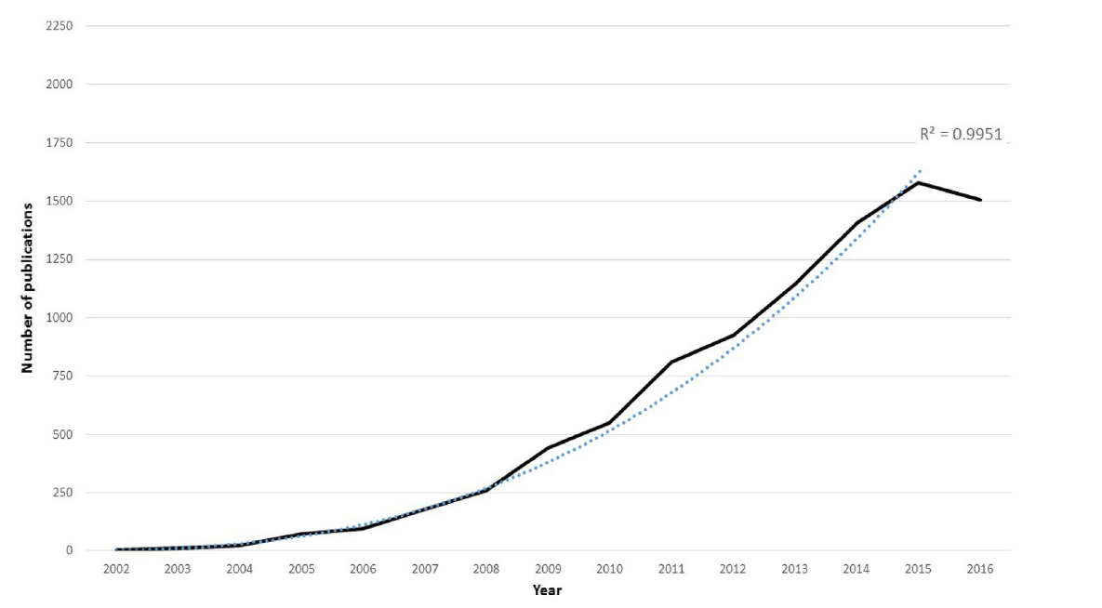
Publications on metagenomics 2002-2016
The metagenomics worldwide research - PubMed (nih.gov)

Slide 21
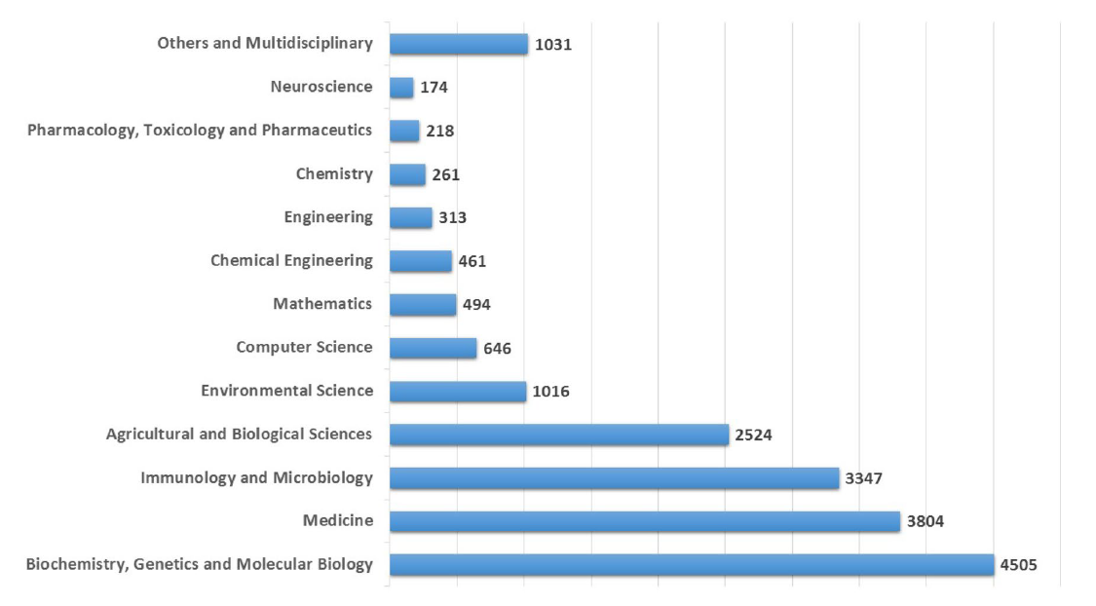
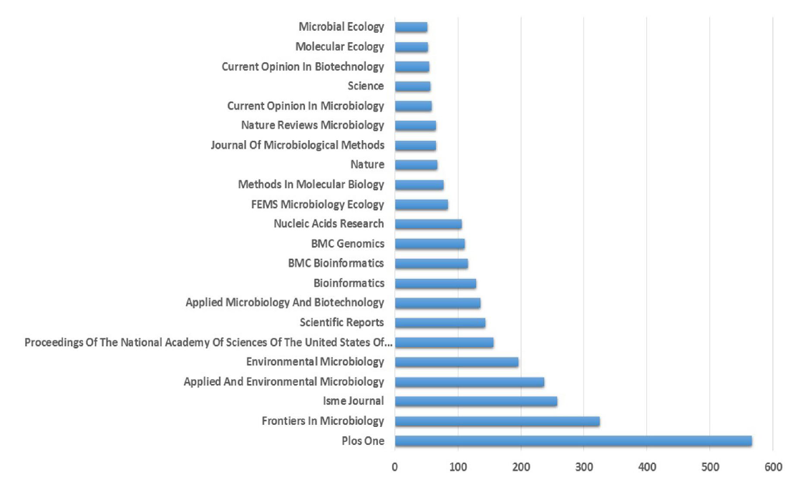
Distribution of publications by field and journals
The metagenomics worldwide research - PubMed (nih.gov)

Slide 22
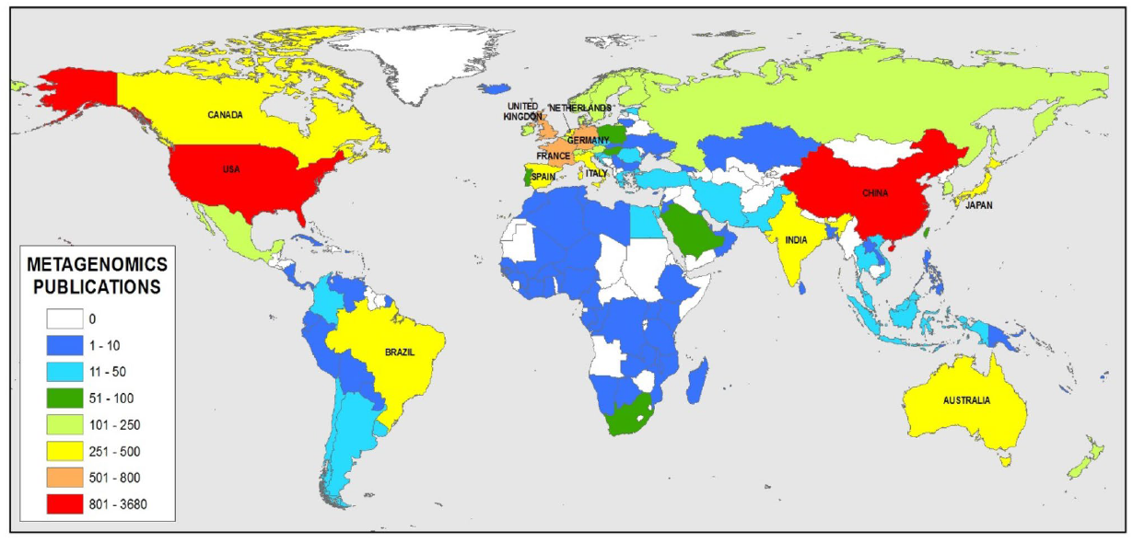
Distribution of publications by countries
The metagenomics worldwide research - PubMed (nih.gov)

Slide 23
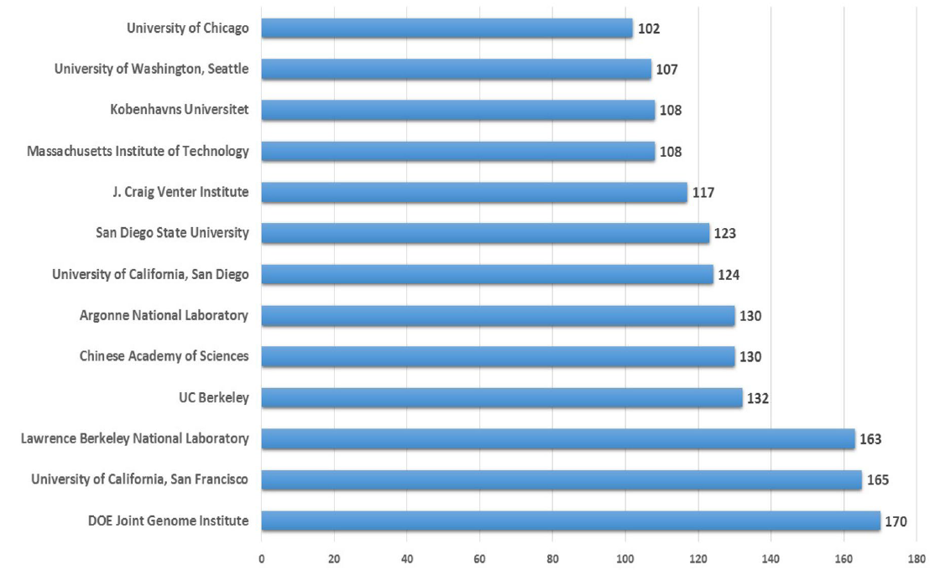
Main institutions in metagenomic publications
The metagenomics worldwide research - PubMed (nih.gov)

Slide 24
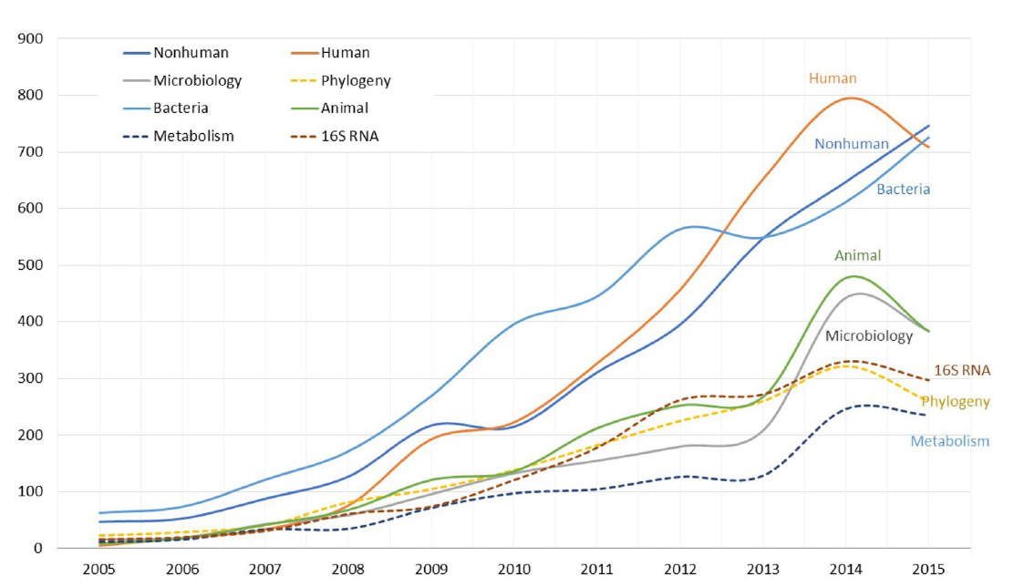
Main keywords in metagenomic publications
The metagenomics worldwide research - PubMed (nih.gov)

Slide 25
Main steps in metagenomic analyses
Gather raw data (we will provide demo shotgun metagenomics fastq files)
Evaluate data quality
Adapter trimming and data quality filtering
Fastqc
Trimmomatic
Build database for classification (RefSeq), get taxonomic profiles, convert to tables
Convert sam to bam, extract unmapped reads, sort bam files, convert bam to fastq
Host genome removal (Download host genome, build database, map all reads against database)
Kaiju
Samtools
Bowtie2
Assemble genomes from unmapped fastq files
Quality assessment of assembled genomes, get contig details, N50, graphs
Build database from assembled genomes, indexing assemblies, get assembly stats
Megahit
Metaquast
Bowtie2, samtools
Predict open reading frames from assembly
Evaluate bins for completeness and contamination but assessing single copy genes
Binning contigs into separate taxonomic identities to get ‘Metagenome assembled genomes (MAGs)’
Prodigal
CheckM
MetaBAT

Slide 26
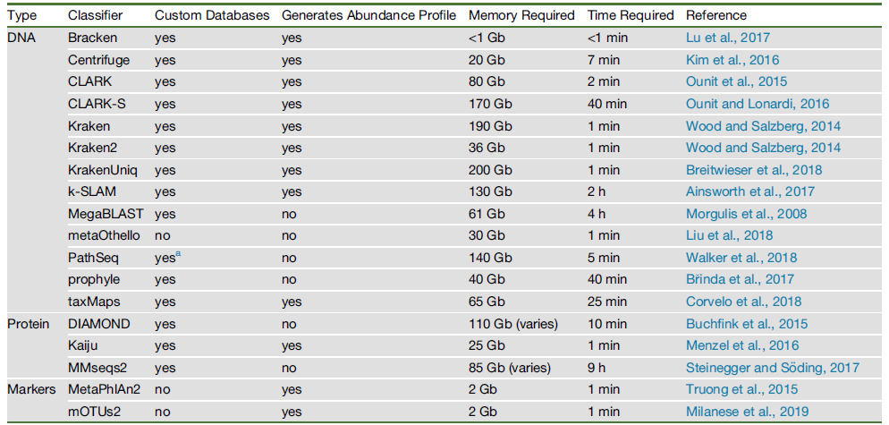
Benchmarking of major metagenomic classifiers
Benchmarking Metagenomics Tools for Taxonomic Classification - ScienceDirect

Slide 27
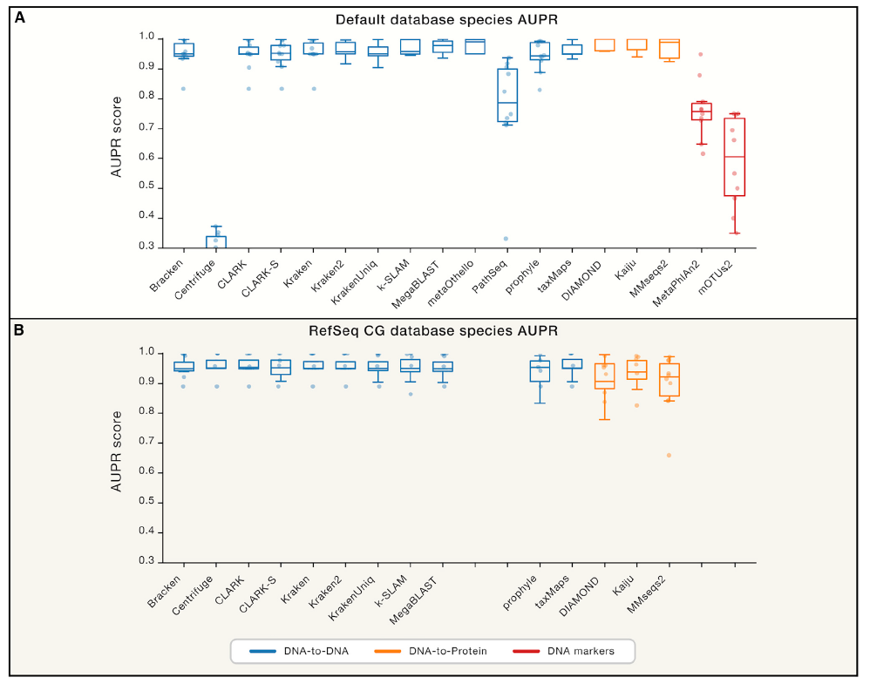
Benchmarking of major metagenomic classifiers with AUPR scores
Benchmarking Metagenomics Tools for Taxonomic Classification - ScienceDirect

Slide 28
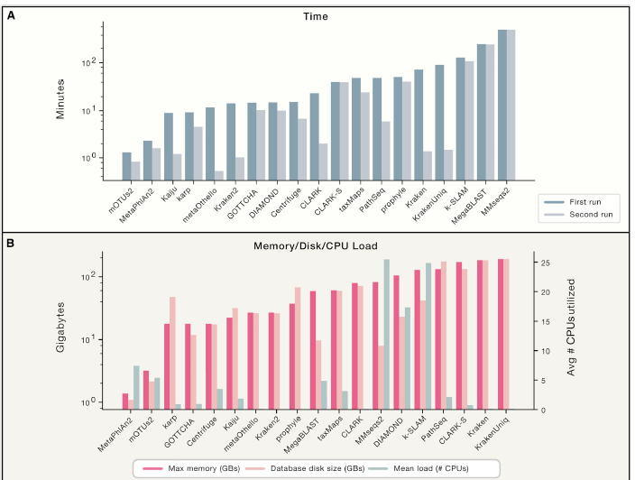
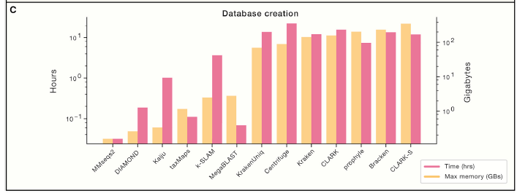
Computational requirements of major classifiers
Benchmarking Metagenomics Tools for Taxonomic Classification - ScienceDirect

Slide 29
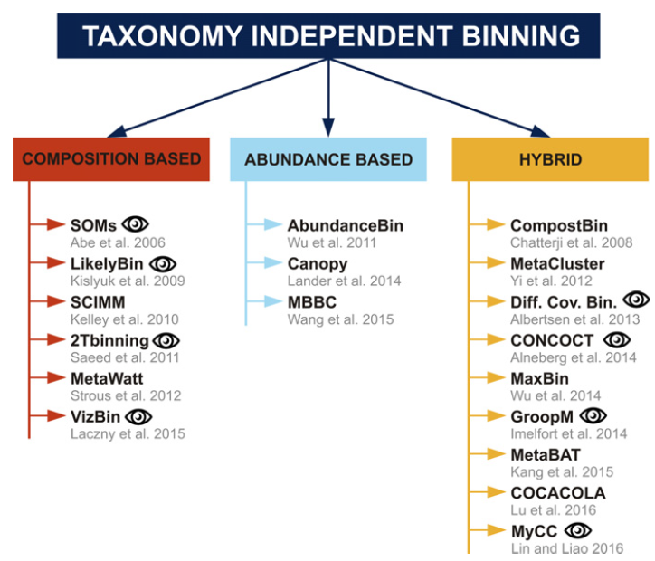
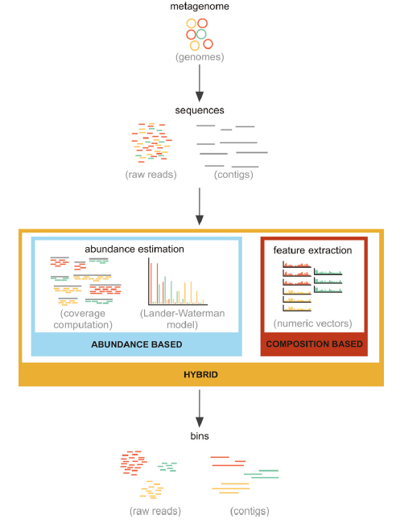
Binning strategies
Bioinformatics strategies for taxonomy independent binning and visualization of sequences in shotgun metagenomics - PubMed (nih.gov)

Slide 30
Major achievements of metagenomic studies
Discovery of genomic and taxonomic novelties in various environments
Innovative functions in uncultivable microbes
Deciphering and rebuilding microbial communities
City-scale molecular profiling of DNA
The human microbiome
Biomedical significance
Mining of microbial genes in vivo
Biotechnological impact
Metagenomic Approaches for Understanding New Concepts in Microbial Science (hindawi.com)

Slide 31
Limitations and opportunities in metagenomics
Entry-level access
Comprehensiveness of genome catalogs
Biases in functional profiling
Microbial dark matter
Live or dead dilemma
Curse of compositionality
Mucosa-associated microbiome profiling
Strain-level profiling
Virome –shotgun sequencing
Integrative meta-omics
Longitudinal study design
Disentangling cause from effect
Validation of microbiome biomarkers
Data sharing and analyses reproducibility
Shotgun metagenomics, from sampling to analysis | Nature Biotechnology

Slide 32
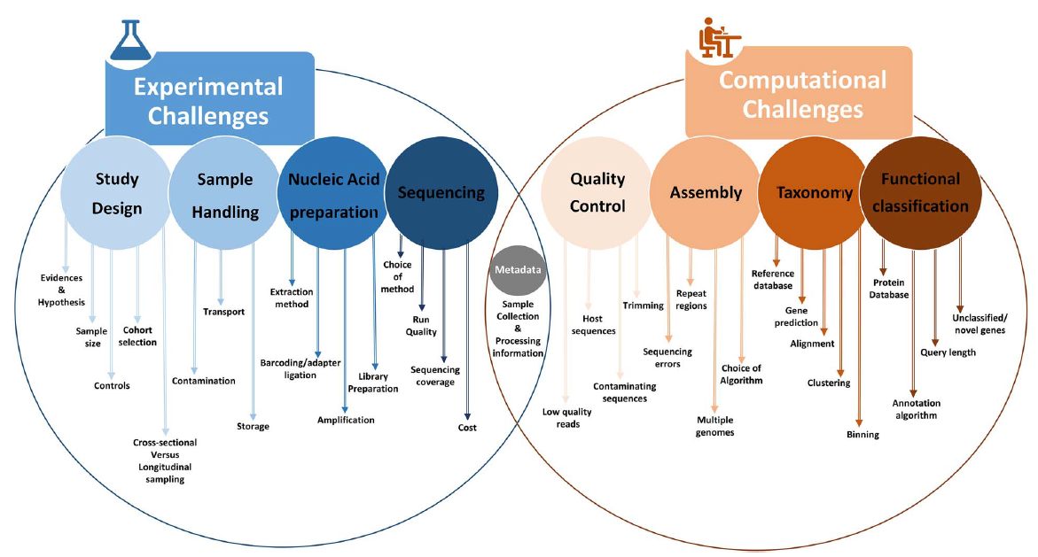
Challenges in metagenomics
Current challenges and best-practice protocols for microbiome analysis | Briefings in Bioinformatics | Oxford Academic (oup.com)

Slide 33
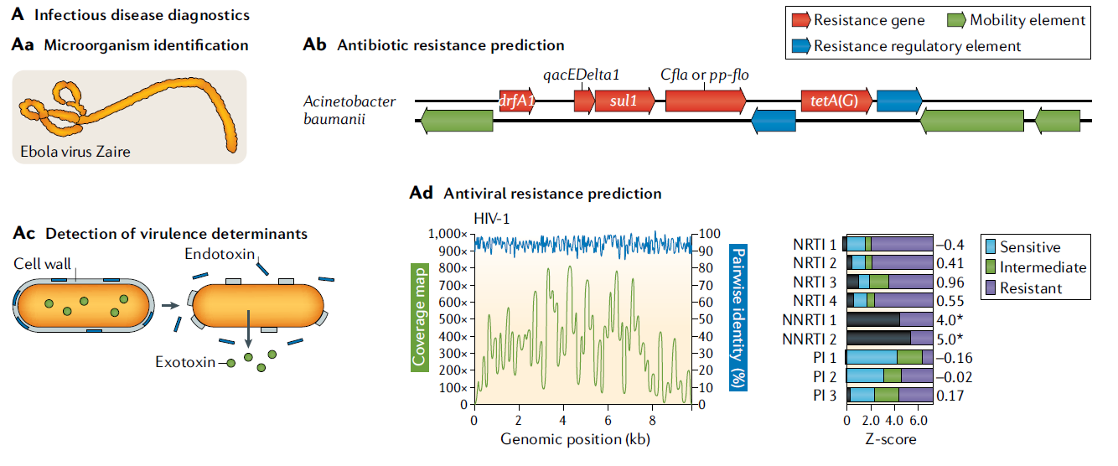
Clinical applications of metagenomics
Clinical metagenomics | Nature Reviews Genetics

Slide 34
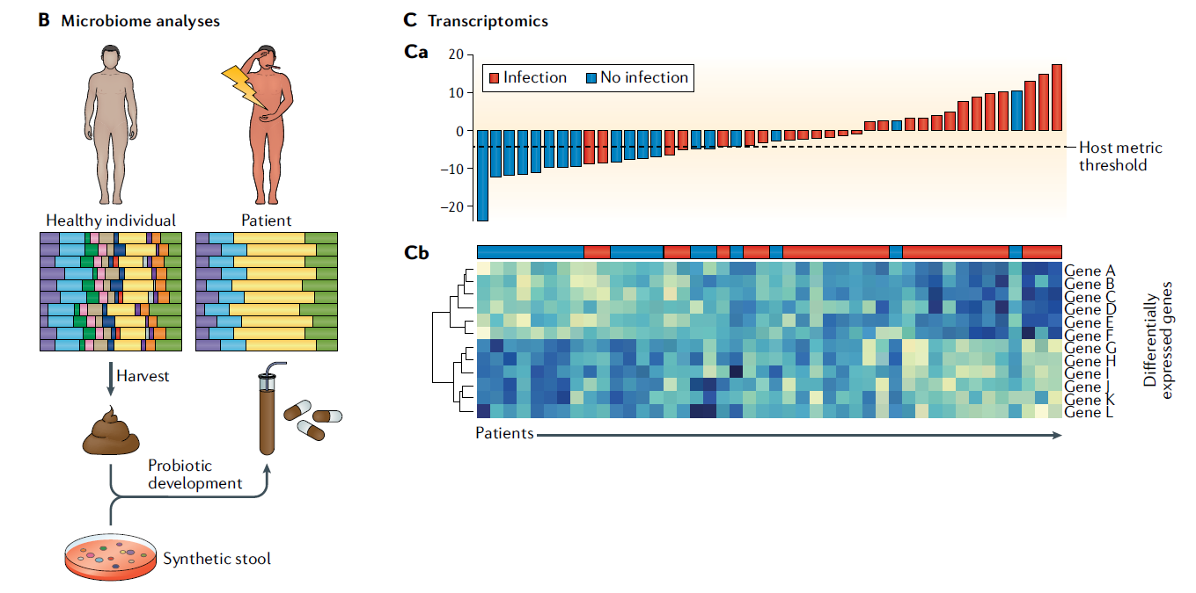
Clinical applications of metagenomics cont…
Clinical metagenomics | Nature Reviews Genetics

Slide 35
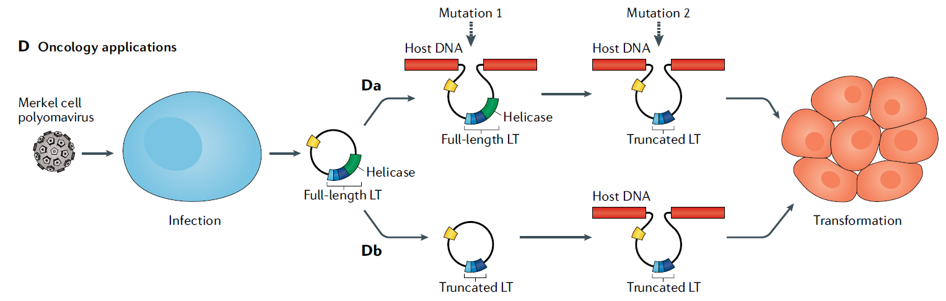
Clinical applications of metagenomics cont…
Clinical metagenomics | Nature Reviews Genetics

Slide 36
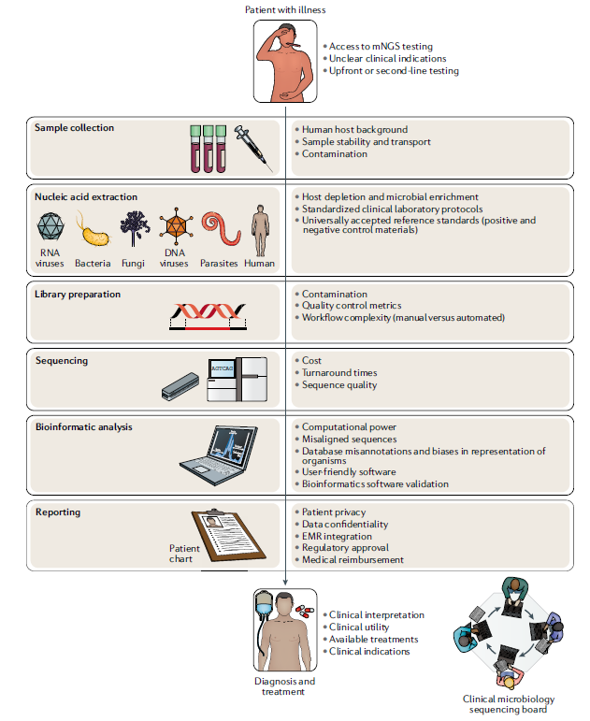
Challenges for clinical applications of metagenomics
Clinical metagenomics - PubMed (nih.gov)

Slide 37
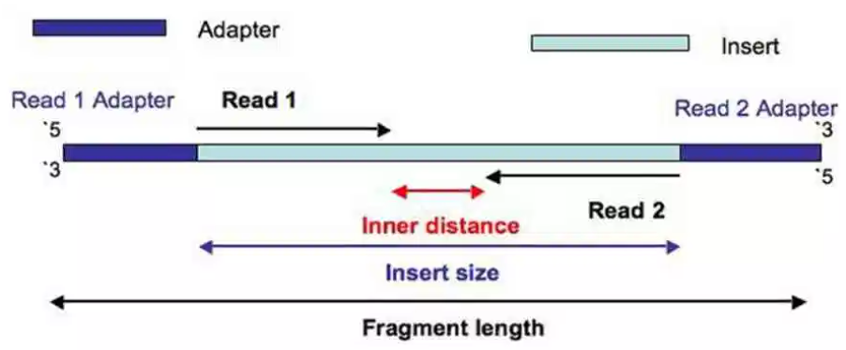
Paired-end sequencing of 16S amplicons
https://thesequencingcenter.com/knowledge-base/what-are-paired-end-reads/

Slide 38
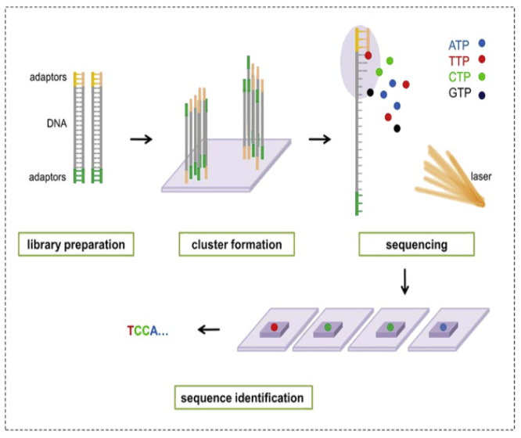
Illumina sequencing of by synthesis
Illumina Dye Sequencing - an overview | ScienceDirect Topics

Slide 39
Summary of metagenomic analysis
Quince, Christopher, et al. Nature biotechnology 35.9 (2017): 833.

Slide 40
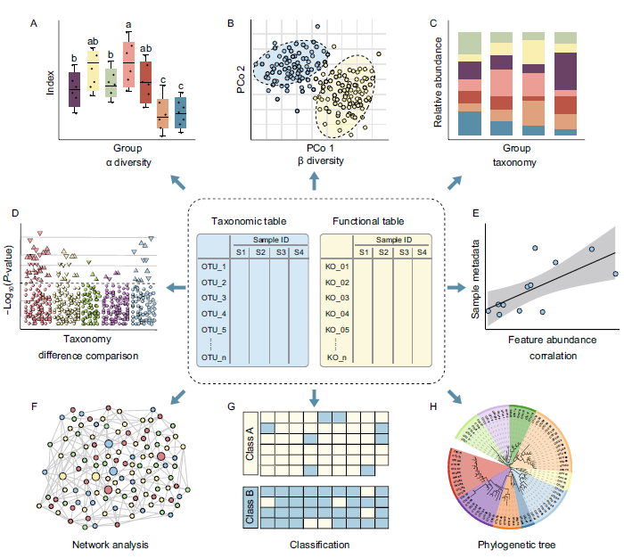
Visualization methods for microbiome analyses
A practical guide to amplicon and metagenomic analysis of microbiome data | SpringerLink

Slide 41
Tools and servers for microbiome data analysis
Malla, Muneer Ahmad, et al. Frontiers in immunology 9 (2018).
Mallick, Himel, et al. Genome biology18.1 (2017): 228.

Slide 42
Metatranscriptomics
Metatranscriptomics provides a detailed insight into the active functionalities of the microbial community
16S and metagenomics can catalogue the microbes present, but cannot differentiate between inactive or active members of the community
Metatranscriptomics helps in understanding the function of a microbial community over time or in response to altered environmental conditions
Can help in understanding the role of coding and non-coding RNAs
It can help in understanding the host-microbe interactions

Slide 43
Metatranscriptomics approach for microbiome
Experimental
Bioinformatic
https://www.cd-genomics.com/the-principles-workflow-and-applications-of-metatranscriptomic-sequencing.html

Slide 44
Metaproteomics
As the name suggests, it refers to the large-scale analysis of proteins from the microbial community
The purpose is to understand the functions and interactions in the microbiota
It can also be used to identify the host-microbiota interactions at normal and diseased state
As proteins are main players of biochemical reactions and cellular processes, identification of their subcellular localization is also important to understand their function which is possible through metaproteomics.

Slide 45
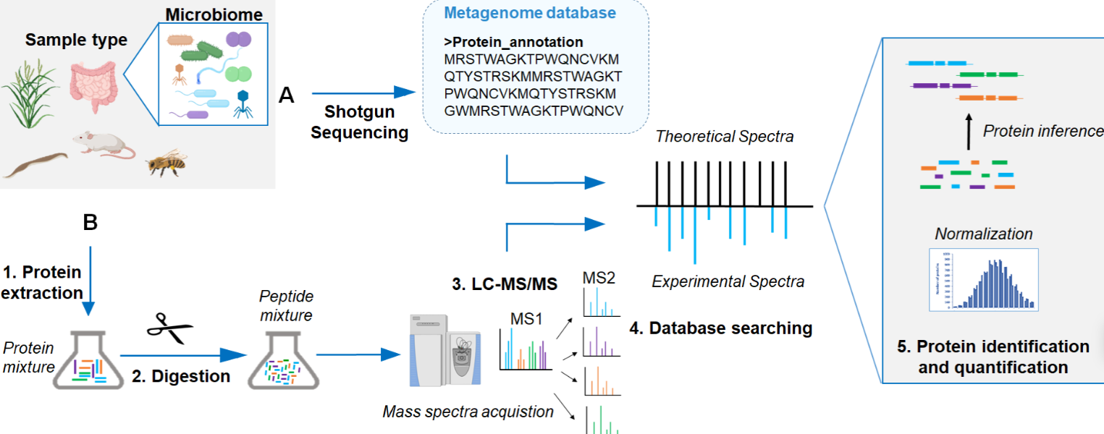
Insights into Metaproteomics
Prerequisites:
High resolution liquid chromatography
Mass spectrometry
Comprehensive reference database
Metaproteomics workflow
Five key aspects of metaproteomics as a tool to understand functional interactions in host-associated microbiomes (plos.org)

Slide 46
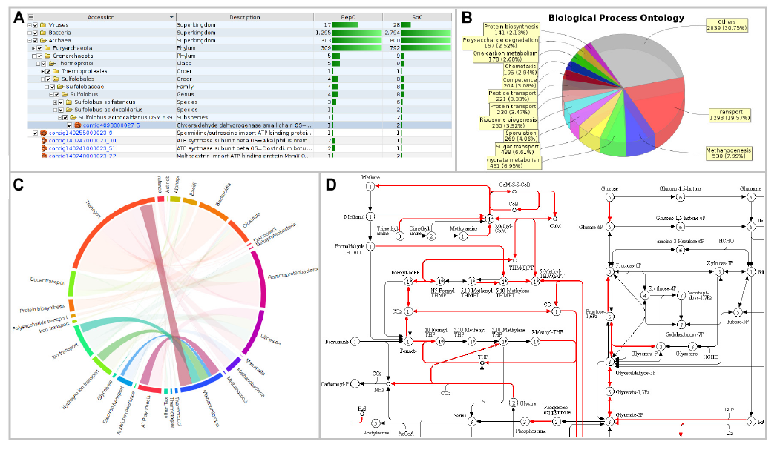
Data visualization and analysis
https://doi.org/10.3389/fmicb.2019.01883

Slide 47
Metabolomics
Complete analyses of small molecules (metabolites) from a cell, organ, biofluid or organism is termed as metabolomics
In general, it is usually < 1500 Da
In other words, metabolites can be endogenous compounds such as lipids, amino acids, short peptides, nucleic acids, sugars, alcohols, or organic acids that are routinely produced by endogenous catabolism
or anabolism
Some critical metabolites include essential amino acids and few vitamins

Slide 48
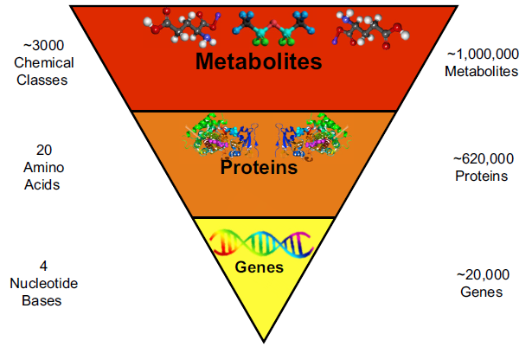
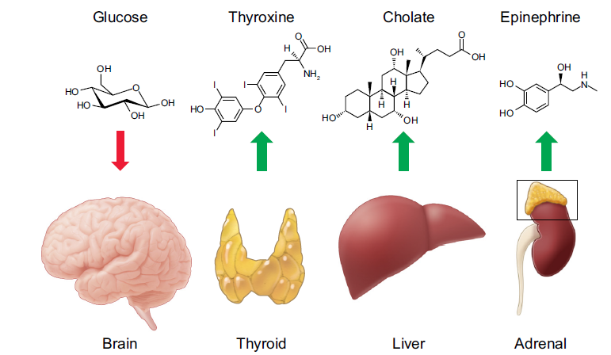
Metabolomics is not easy
Metabolomics for Investigating Physiological and Pathophysiological Processes - PubMed (nih.gov)

Slide 49
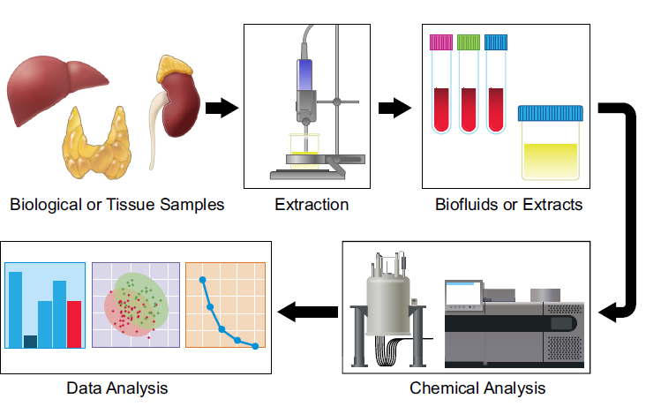
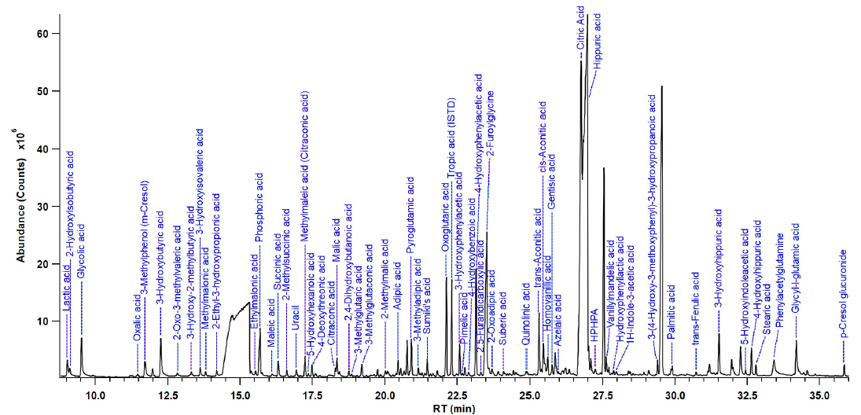
Metabolomics workflow
Metabolomics for Investigating Physiological and Pathophysiological Processes - PubMed (nih.gov)

Slide 50
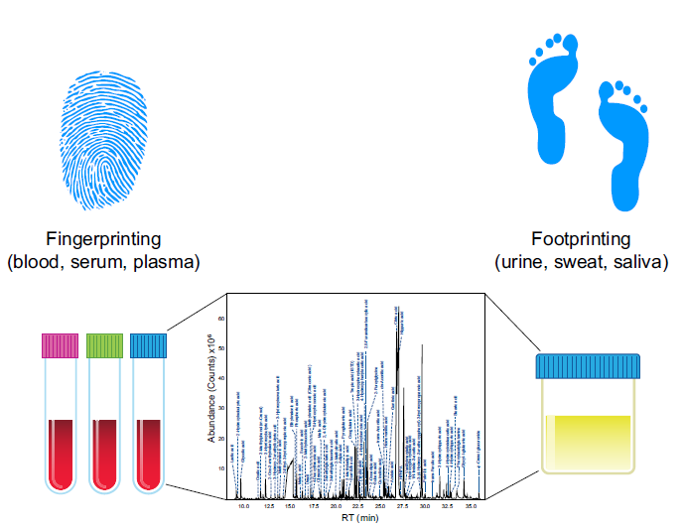
Metabolomics fingerprinting and footprinting
Metabolomics for Investigating Physiological and Pathophysiological Processes - PubMed (nih.gov)

Slide 51
Glycomics
Glycome refers to the complex mixture of all glycans in an organism or a biofluid such as serum
Glycans which are ‘sugar trees’ are created, altered and attached to thousands of proteins (glycoproteins) and lipids (glycolipids)
Currently, more than 100 diseases are known to occur in human, which are mostly metabolic disorders and are known as ‘Congenital Disorders of Glycosylation (CDGs)’
It can have considerable health outcomes including severe epilepsy, growth defects and heart diseases

Slide 52
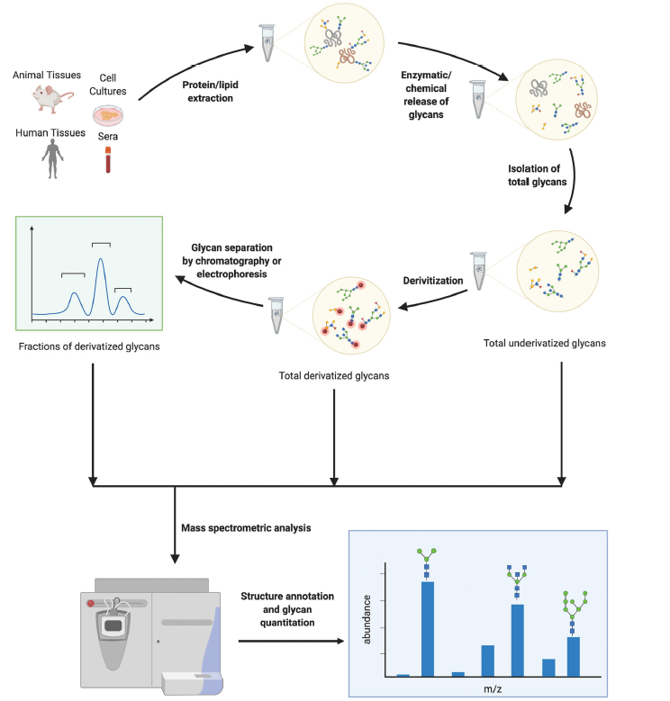
Glycomics workflow
Full article: Sweet systems: technologies for glycomic analysis and their integration into systems biology (tandfonline.com)

Slide 53
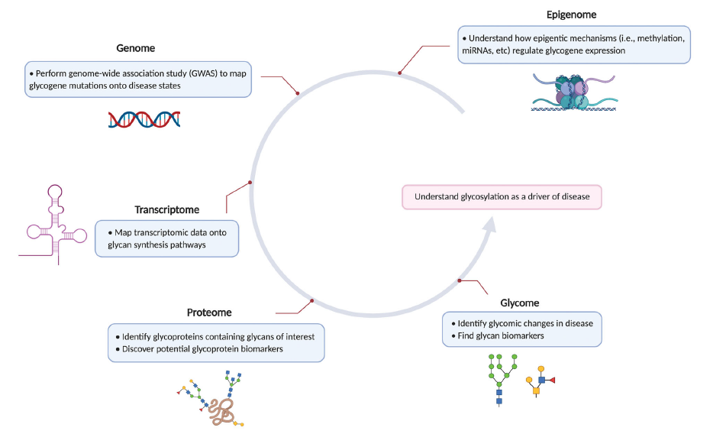
Integrating glycomics to Omics studies
Full article: Sweet systems: technologies for glycomic analysis and their integration into systems biology (tandfonline.com)

Slide 54
Integrating multi-omics data for microbiome
Franzosa, Eric A., et al. Nature Reviews Microbiology 13.6 (2015): 360.

Slide 55
Major ongoing microbiome projects for human diseases
Valencia, Pedro M., et al. "The human microbiome: opportunity or hype?." (2017): 823.

Slide 56
Challenges for microbiome research
https://www.ncbi.nlm.nih.gov/pubmed/30096310

Slide 57
Ethical issues of human microbiome study
Human microbiome and personal identity
Psychological and social risks
Protection of privacy
Vulnerability of participants
Biobanks and ownership
Hype in microbiome research and its dangers

Slide 58
Thank the microbiome
Celebrate world microbiome day:
Take a deep breath and thank the microbiome for clean air and oxygen
Treat yourself with fermented foods and drinks
Say no to antibiotics, unless prescribed. Avoid soap with antibiotics

Slide 59
